Slide 1
Chapter 7
Digital Design and Computer Architecture, 2nd Edition
David Money Harris and Sarah L. Harris

Slide 2
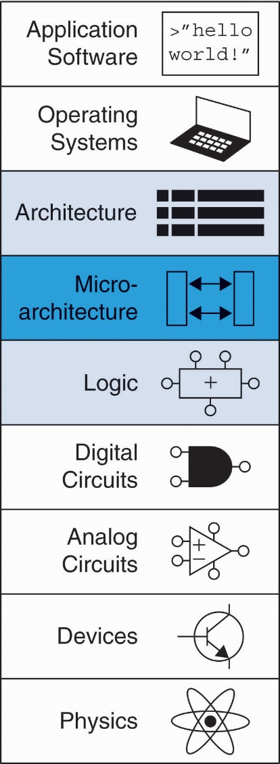
Chapter 7 :: Topics
Introduction
Performance Analysis
Single-Cycle Processor
Multicycle Processor
Pipelined Processor
Exceptions
Advanced Microarchitecture

Slide 3
Pipelined MIPS Processor
Temporal parallelism
Divide single-cycle processor into 5 stages:
Fetch
Decode
Execute
Memory
Writeback
Add pipeline registers between stages

Slide 4
Single-Cycle vs. Pipelined

Slide 5
Pipelined Processor Abstraction

Slide 6
Single-Cycle & Pipelined Datapath

Slide 7
Corrected Pipelined Datapath
WriteReg must arrive at same time as Result

Slide 8
Pipelined Processor Control
Same control unit as single-cycle processor
Control delayed to proper pipeline stage

Slide 9
Pipeline Hazards
When an instruction depends on result from instruction that hasn’t completed
Types:
Data hazard: register value not yet written back to register file
Control hazard: next instruction not decided yet (caused by branches)

Slide 10
Data Hazard

Slide 11
Handling Data Hazards
Insert nops in code at compile time
Rearrange code at compile time
Forward data at run time
Stall the processor at run time

Slide 12
Compile-Time Hazard Elimination
Insert enough nops for result to be ready
Or move independent useful instructions forward

Slide 13
Data Forwarding

Slide 14
Data Forwarding

Slide 15
Data Forwarding
Forward to Execute stage from either:
Memory stage or
Writeback stage
Forwarding logic for ForwardAE:
if ((rsE != 0) AND (rsE == WriteRegM) AND RegWriteM)
then ForwardAE = 10
else if ((rsE != 0) AND (rsE == WriteRegW) AND RegWriteW)
then ForwardAE = 01
else ForwardAE = 00
Forwarding logic for ForwardBE same, but replace rsE with rtE

Slide 16
Stalling

Slide 17
Stalling

Slide 18
Stalling Hardware

Slide 19
Stalling Logic
lwstall =
((rsD==rtE) OR (rtD==rtE)) AND MemtoRegE
StallF = StallD = FlushE = lwstall

Slide 20
Control Hazards
beq:
branch not determined until 4th stage of pipeline
Instructions after branch fetched before branch occurs
These instructions must be flushed if branch happens
Branch misprediction penalty
number of instruction flushed when branch is taken
May be reduced by determining branch earlier

Slide 21
Control Hazards: Original Pipeline

Slide 22
Control Hazards

Slide 23
Early Branch Resolution
Introduced another data hazard in Decode stage

Slide 24
Early Branch Resolution

Slide 25
Handling Data & Control Hazards

Slide 26
Control Forwarding & Stalling Logic
Forwarding logic:
ForwardAD = (rsD !=0) AND (rsD == WriteRegM) AND RegWriteM
ForwardBD = (rtD !=0) AND (rtD == WriteRegM) AND RegWriteM
Stalling logic:
branchstall = BranchD AND RegWriteE AND
(WriteRegE == rsD OR WriteRegE == rtD)
OR
BranchD AND MemtoRegM AND
(WriteRegM == rsD OR WriteRegM == rtD)
StallF = StallD = FlushE = lwstall OR branchstall

Slide 27
Branch Prediction
Guess whether branch will be taken
Backward branches are usually taken (loops)
Consider history to improve guess
Good prediction reduces fraction of branches requiring a flush

Slide 28
Pipelined Performance Example
SPECINT2000 benchmark:
25% loads
10% stores
11% branches
2% jumps
52% R-type
Suppose:
40% of loads used by next instruction
25% of branches mispredicted
All jumps flush next instruction
What is the average CPI?

Slide 29
Pipelined Performance Example
SPECINT2000 benchmark:
25% loads
10% stores
11% branches
2% jumps
52% R-type
Suppose:
40% of loads used by next instruction
25% of branches mispredicted
All jumps flush next instruction
What is the average CPI?
Load/Branch CPI = 1 when no stalling, 2 when stalling
CPI_{lw} = 1(0.6) + 2(0.4) = 1.4
CPI_{beq} = 1(0.75) + 2(0.25) = 1.25
Average CPI = (0.25)(1.4) + (0.1)(1) + (0.11)(1.25) + (0.02)(2) + (0.52)(1)
= 1.15

Slide 30
Pipelined Performance
Pipelined processor critical path:
T_{c} = max {
t_{pcq} + t_{mem} + t_{setup}
2(t_{RFread} + t_{mux} + t_{eq} + t_{AND} + t_{mux} + t_{setup} )
t_{pcq} + t_{mux} + t_{mux} + t_{ALU} + t_{setup}
t_{pcq} + t_{memwrite} + t_{setup}
2(t_{pcq} + t_{mux} + t_{RFwrite}) }

Slide 31
Pipelined Performance Example
Element | Parameter | Delay (ps)
Register clock-to-Q | t_{pcq_PC} | 30
Register setup | t_{setup} | 20
Multiplexer | t_{mux} | 25
ALU | t_{ALU} | 200
Memory read | t_{mem} | 250
Register file read | t_{RFread} | 150
Register file setup | t_{RFsetup} | 20
Equality comparator | t_{eq} | 40
AND gate | t_{AND} | 15
Memory write | T_{memwrite} | 220
Register file write | t_{RFwrite} | 100 ps
T_{c} = 2(t_{RFread} + t_{mux} + t_{eq} + t_{AND} + t_{mux} + t_{setup} )
= 2[150 + 25 + 40 + 15 + 25 + 20] ps = 550 ps

Slide 32
Pipelined Performance Example
Program with 100 billion instructions
Execution Time = (# instructions) × CPI × T_{c}
= (100 × 10⁹)(1.15)(550 × 10⁻¹²)
= 63 seconds

Slide 33
Processor Performance Comparison
Processor | Execution Time (seconds) | Speedup (single-cycle as baseline)
Single-cycle | 92.5 | 1
Multicycle | 133 | 0.70
Pipelined | 63 | 1.47

Slide 34
Review: Exceptions
Unscheduled function call to exception handler
Caused by:
Hardware, also called an interrupt, e.g. keyboard
Software, also called traps, e.g. undefined instruction
When exception occurs, the processor:
Records cause of exception (Cause register)
Jumps to exception handler (0x80000180)
Returns to program (EPC register)

Slide 35
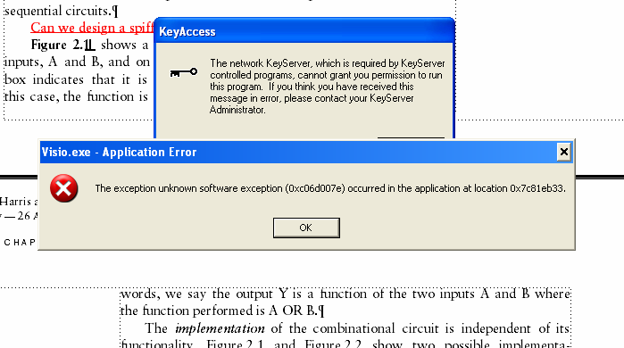
Example Exception

Slide 36
Exception Registers
Not part of register file
Cause
Records cause of exception
Coprocessor 0 register 13
EPC (Exception PC)
Records PC where exception occurred
Coprocessor 0 register 14
Move from Coprocessor 0
mfc0 $t0, Cause
Moves contents of Cause into $t0

Slide 37
Exception Causes
Exception | Cause
Hardware Interrupt | 0x00000000
System Call | 0x00000020
Breakpoint / Divide by 0 | 0x00000024
Undefined Instruction | 0x00000028
Arithmetic Overflow | 0x00000030
Extend multicycle MIPS processor to handle last two types of exceptions

Slide 38
Exception Hardware: EPC & Cause

Slide 39
Control FSM with Exceptions

Slide 40
Exception Hardware: mfc0

Slide 41
Advanced Microarchitecture
Deep Pipelining
Branch Prediction
Superscalar Processors
Out of Order Processors
Register Renaming
SIMD
Multithreading
Multiprocessors

Slide 42
Deep Pipelining
10-20 stages typical
Number of stages limited by:
Pipeline hazards
Sequencing overhead
Power
Cost

Slide 43
Branch Prediction
Ideal pipelined processor: CPI = 1
Branch misprediction increases CPI
Static branch prediction:
Check direction of branch (forward or backward)
If backward, predict taken
Else, predict not taken
Dynamic branch prediction:
Keep history of last (several hundred) branches in branch target buffer, record:
Branch destination
Whether branch was taken

Slide 44
Branch Prediction Example
add $s1, $0, $0 # sum = 0
add $s0, $0, $0 # i = 0
addi $t0, $0, 10 # $t0 = 10
for:
beq $s0, $t0, done # if i == 10, branch
add $s1, $s1, $s0 # sum = sum + i
addi $s0, $s0, 1 # increment i
j for
done:

Slide 45
1-Bit Branch Predictor
Remembers whether branch was taken the last time and does the same thing
Mispredicts first and last branch of loop

Slide 46
2-Bit Branch Predictor
Only mispredicts last branch of loop

Slide 47
Superscalar
Multiple copies of datapath execute multiple instructions at once
Dependencies make it tricky to issue multiple instructions at once

Slide 48
Superscalar Example
lw $t0, 40($s0)
add $t1, $t0, $s1
sub $t0, $s2, $s3 Ideal IPC: 2
and $t2, $s4, $t0 Actual IPC: 2
or $t3, $s5, $s6
sw $s7, 80($t3)

Slide 49
Superscalar with Dependencies
lw $t0, 40($s0)
add $t1, $t0, $s1
sub $t0, $s2, $s3 Ideal IPC: 2
and $t2, $s4, $t0 Actual IPC: 6/5 = 1.17
or $t3, $s5, $s6
sw $s7, 80($t3)

Slide 50
Out of Order Processor
Looks ahead across multiple instructions
Issues as many instructions as possible at once
Issues instructions out of order (as long as no dependencies)
Dependencies:
RAW (read after write): one instruction writes, later instruction reads a register
WAR (write after read): one instruction reads, later instruction writes a register
WAW (write after write): one instruction writes, later instruction writes a register

Slide 51
Out of Order Processor
Instruction level parallelism (ILP): number of instruction that can be issued simultaneously (average < 3)
Scoreboard: table that keeps track of:
Instructions waiting to issue
Available functional units
Dependencies

Slide 52
Out of Order Processor Example
lw $t0, 40($s0)
add $t1, $t0, $s1
sub $t0, $s2, $s3 Ideal IPC: 2
and $t2, $s4, $t0 Actual IPC: 6/4 = 1.5
or $t3, $s5, $s6
sw $s7, 80($t3)

Slide 53
Register Renaming
lw $t0, 40($s0)
add $t1, $t0, $s1
sub $t0, $s2, $s3 Ideal IPC: 2
and $t2, $s4, $t0 Actual IPC: 6/3 = 2
or $t3, $s5, $s6
sw $s7, 80($t3)

Slide 54
SIMD
Single Instruction Multiple Data (SIMD)
Single instruction acts on multiple pieces of data at once
Common application: graphics
Perform short arithmetic operations (also called packed arithmetic)
For example, add four 8-bit elements

Slide 55
Advanced Architecture Techniques
Multithreading
Wordprocessor: thread for typing, spell checking, printing
Multiprocessors
Multiple processors (cores) on a single chip

Slide 56
Threading: Definitions
Process: program running on a computer
Multiple processes can run at once: e.g., surfing Web, playing music, writing a paper
Thread: part of a program
Each process has multiple threads: e.g., a word processor may have threads for typing, spell checking, printing

Slide 57
Threads in Conventional Processor
One thread runs at once
When one thread stalls (for example, waiting for memory):
Architectural state of that thread stored
Architectural state of waiting thread loaded into processor and it runs
Called context switching
Appears to user like all threads running simultaneously

Slide 58
Multithreading
Multiple copies of architectural state
Multiple threads active at once:
When one thread stalls, another runs immediately
If one thread can’t keep all execution units busy, another thread can use them
Does not increase instruction-level parallelism (ILP) of single thread, but increases throughput
Intel calls this “hyperthreading”

Slide 59
Multiprocessors
Multiple processors (cores) with a method of communication between them
Types:
Homogeneous: multiple cores with shared memory
Heterogeneous: separate cores for different tasks (for example, DSP and CPU in cell phone)
Clusters: each core has own memory system

Slide 60
Other Resources
Patterson & Hennessy’s: Computer Architecture: A Quantitative Approach
Conferences:
www.cs.wisc.edu/~arch/www/
ISCA (International Symposium on Computer Architecture)
HPCA (International Symposium on High Performance Computer Architecture)

